Slide 1
Investigating the History of Kent
Key question:
Which event had the greatest impact on the people of Kent?
LESSONS 7 - 11
J Salmon Ltd

Slide 2
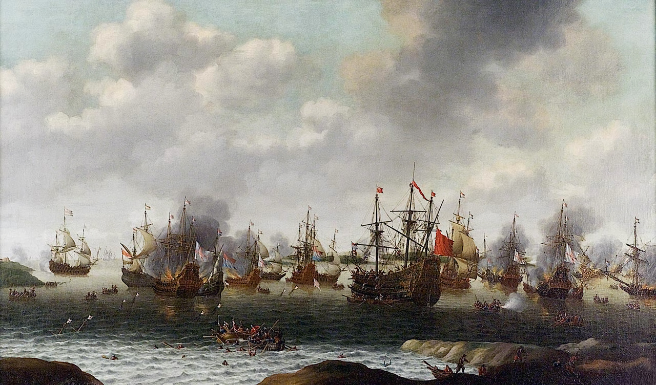
Lesson 7:
STARTER:
What is happening in this picture?
(Who? Where? When?)
https://commons.wikimedia.org/wiki/File:Van_Soest,_Attack_on_the_Medway.jpg

Slide 3
Lesson 7: Why did the Dutch attack Chatham in 1667?
Learning Objectives:
Grade 3+: to explain why the Dutch decided to attack in 1667
Grade 5+: to discuss what happened during the attack
Grade 7+: to evaluate the effects of the attack

Slide 4
Why did the Dutch attack?
King Charles II had been plagued (quite literally) with problems since he became King in 1660. In 1665, the Great Plague had ravaged London and then the Great Fire of London burnt a third of the city to the ground. This had left the King in serious debt and unable to properly maintain his navy.
The English and the Dutch had been fighting over trade. During the English Civil War in the 1640s the Dutch had taken the opportunity to dominate trade and Charles II was keen to get back control. However, after the events of 1665-66, he had entered into peace negotiations with the Netherlands. But he was deliberately delaying and the Dutch decided to achieve a final victory…

Slide 5
Charles II had sent most of his sailors home because he could not afford to pay them. The River Medway was protected by just three ships and a large iron chain (the Gillingham Line) that had been stretched from one bank to the other.
Activity: Looking at the information and the map, explain why the Dutch decided to attack when and where they did.
https://en.wikipedia.org/wiki/Raid_on_the_Medway#/media/File:MedwayRaidMap.png

Slide 6
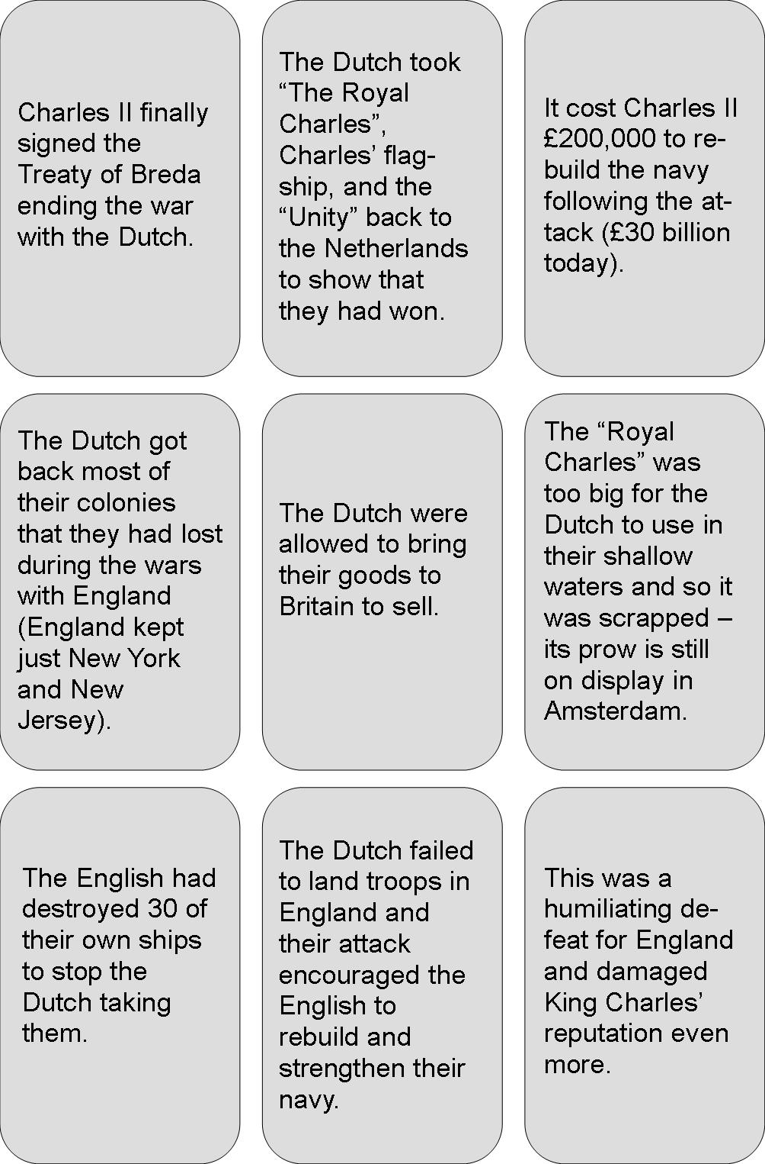
Watch the video.
Make brief notes about what happened during the attack.
Activity:
Look at the consequences cards. Organise them into an order of importance.
Why did you choose
your most important
consequence?
Most important
Least important
Notes:
From 15mins in – for about 6 mins.

Slide 7
Plenary
Fill in your importance card for this event

Slide 8
Lesson 8: How did ‘Captain Swing’ affect Kent?
Learning Objectives:
Grade 3+: to explain why life was difficult for ordinary people in the Kent countryside in the 19th century
Grade 5+: to discuss why riots took place in Kent in 1830-1
Grade 7+: to evaluate whether the problems caused by new technology in the 19th century are still relevant today

Slide 9
Starter: What were the causes of the Peasants’ Revolt in 1381?
Low pay
Very few freedoms for peasants
An unpopular King and Government
High taxes to pay for a war
A shortage of workers
Most land was owned by the rich
Which of these problems do you think still existed at the start of the 19th century?
Extension: Can you think of any other problems there might have been by then?

Slide 10
Activity:
You have a box full of clues about today’s event.
In your groups, you have to work out what happened in the early 1830s. Divide the clues between you.
Then answer all the questions on the sheet.

Slide 11
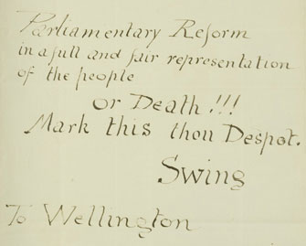
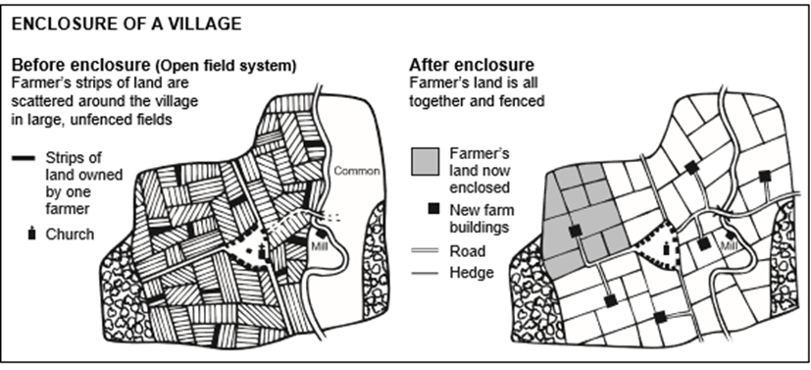
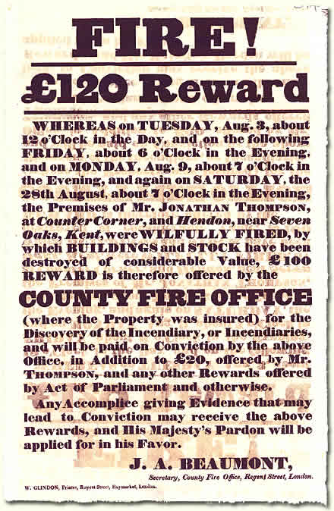
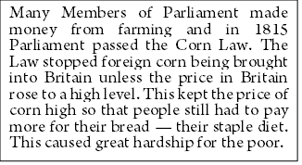
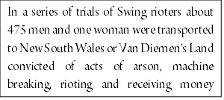
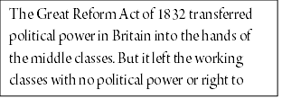
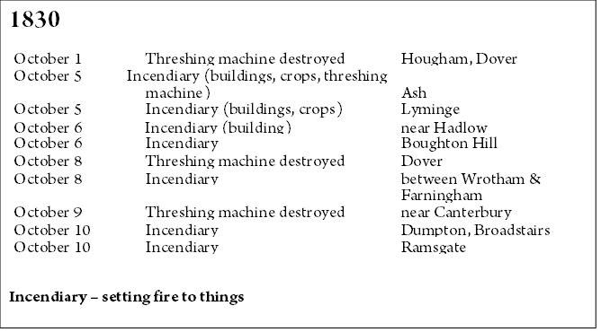
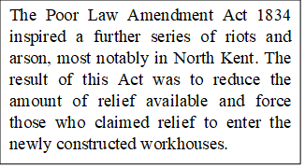
THE CLUES

Slide 12
1. A law stopping foreign corn being brought into the country unless prices were very high. 2. It kept the price of corn and therefore bread too high for poor people to buy. 3. A law giving middle class people the vote for the first time. 4. Working class people still had no political power. 5. A change in the law reducing relief (benefit) payments and forcing people into workhouses instead. 6. It made life for the poor even harder and once in the workhouse it was difficult to get out again. 7. Ordinary people lost a lot of the common land on which they had been able to graze cattle and rich people were able to buy large plots of land. 8. Threshing machines because they could do the job of many men, putting people out of work. 9. They burnt and destroyed farms, crops and threshing machines. 10. The Prime Minister (famous for beating Napoleon at the Battle of Waterloo) 11. He didn’t exist – ‘Swing’ or ‘Captain Swing’ was an anonymous name which appeared on letters which the protestors sent to farmers and landowners 12. The Luddites – protestors who had destroyed machines in the factories in the North and Midlands. 13. Some were transported to Australia as a punishment. 14. Artificial Intelligence perhaps – a real threat for the future?
The Answers!

Slide 13
Activity
“First the machines will do a lot of jobs for us and will not be super intelligent. That should be positive if we manage it well. A few decades after that though the intelligence will be strong enough to be a concern”.
Bill Gates, founder of Microsoft
Do you think the Swing Rioters were right to be concerned about mankind’s increasing use of machines?

Slide 14
Plenary
Fill in your importance card for this event

Slide 15
Look at this poster: a) What is it telling people? b) Who do you think produced it? c) When was it produced?
Creative Commons BY-NC-SA

Slide 16
Lesson 9: 1914-18 How did bombing raids affect the people of Dover and Folkestone?
Learning Objectives:
Grade 3+: to explain why Germany decided to attack Britain from the air during the First World War.
Grade 5+: to demonstrate how the bombing raids affected the people of Folkestone and Dover.
Grade 7+: to evaluate the evidence about the attack on Folkestone and understand the concept of Total War.

Slide 17
Watch the video about Zeppelins
How did Germany attack Britain from the air?
Give three reasons why Germany attacked.
What effect did the air raids have on morale?
Why were the Zeppelins difficult to attack?
What new invention helped to attack Zeppelins?
Notes:
Watch video from 3.38 mins in to 7 mins.

Slide 18
From Dover and the Great War, by J.B. Frith 1919
There were a total of fifty-three Zeppelin and fifty-seven aeroplane raids on Britain during the First World War.
1,413 people were killed and 3,407 injured.

Slide 19
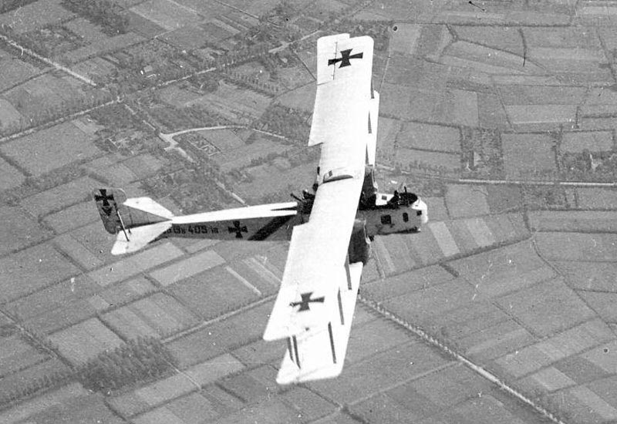
Many people do not realise that Britain was bombed by the Germans during the First World War.
In all, 159 bombs were dropped in or near Folkestone, killing ninety-five people (including thirty women and twenty-five children) and injuring 192.
Gotha Bombers were used by Germany by 1917. Faster and bigger than anything the British had, they caused huge destruction.

Slide 20
Eyewitness Accounts
‘In the late afternoon of a beautiful spring day, ten-year-old Win Reynolds was in the garden of her home in Folkestone, waiting for her aunt to take her shopping, when she heard the drone of aeroplanes. 'They were flying at height where you could see the pilots, 'she recalled, 'and thinking they were ours, I began to wave. I should think there were twenty live planes in all flying about, very low. Other people came out and waved, as did my grandparents, there was no bother at all. We'd never seen aircraft like these before.‘
What does this tell you about the air raid on Folkestone?

Slide 21
Eyewitness Accounts
‘Caught up in the horrific carnage in Tontine Street was Win Reynolds, the young girl who had seen the planes from her garden. After a bomb exploded she was dragged into the nearest shop and taken into the cellar. But she had only been there a few seconds when a lady with two blonde girls, both about five, decided to leave to 'see that her husband was safe'.
Reynolds recalled: 'Well, as she left the shop a bomb fell on Stokes’ greengrocers and she got killed along with the two children with her . . . [She] was supposed to have been picked up with the two children's hands, one in each of her hands, and the children blown to pieces.’
What effect must this have had on the people of Folkestone?

Slide 22
Activities
Look at the source sheet and the following two questions:
1. What do you think the phrase “Total War” means?
2. Why do you think this phrase is used by historians to describe World War 1? Use the sources to explain your answer.

Slide 23
Plenary
Fill in your importance card for this event

Slide 24
Lesson 10: How did Kent fool the Nazis?
Learning Objectives:
Grade 3+: to explain why there was a need to deceive the Nazis in 1944
Grade 5+: to demonstrate how Operation Fortitude was carried out
Grade 7+: to evaluate how significant Operation Fortitude was in the success of D-Day

Slide 25
Starter:
What does this picture show?
Is there anything strange about it?
(Rick Beyer/Hatcher Graduate Library)

Slide 26
World War Two
The Second World War started in 1939 after Hitler invaded Poland. In 1940 he invaded France and Belgium where the British Army (BEF) had been sent to help defend its allies. They were outnumbered and quickly overpowered. In May 1940, the Dunkirk evacuation was launched to save the British army and bring the survivors back home. Although mainland Britain was not invaded, Western Europe remained occupied by the Nazis.
By 1944, a massive sea invasion of Northern France was planned by the British, Canadians and Americans (which became known as D-Day) but they needed the element of surprise to achieve success. So they devised a plan to trick the Nazis. It was code-named Operation Fortitude....

Slide 27
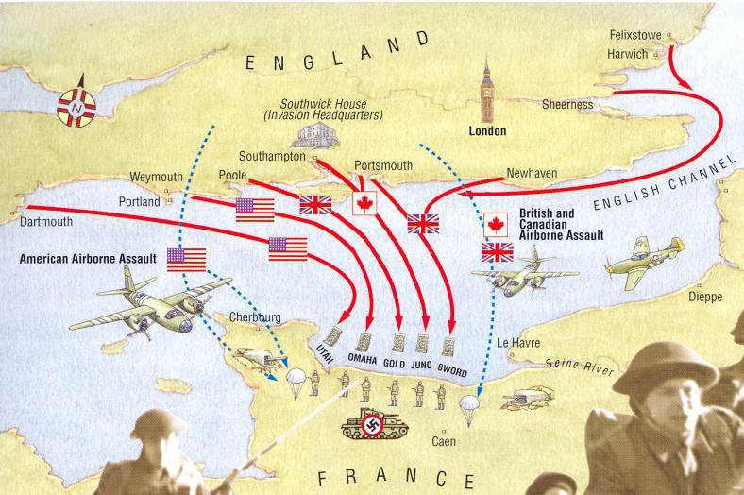
This was the proposed plan for the D-Day invasion on 6th June 1944.
Why was Normandy not the obvious place to attack?
What problems might this plan have presented?
Where would it have been more obvious to attack?
NORMANDY

Slide 28
Operation Fortitude
Watch the video. How did Britain use:
Double agents?
Mock (pretend) invasions?
Fake military equipment?
The 1st US Army Group?
Notes:
Watch video 2.13-9.20 mins

Slide 29
Activity
Imagine that you are a member of the Control Section in London which is planning Operation Fortitude.
You must write a top-secret briefing note to the Prime Minister, Winston Churchill. Explain your plan to trick the Nazis – Operation Fortitude.
What do you propose to do?
How will you fool the Nazis?
Why is it essential to do this?

Slide 30
Plenary
EXTENSION:
Do you think D-Day would have succeeded without Operation Fortitude?
Fill in your importance card for this event

Slide 31
Lesson 11: Kent’s Place in History!
Learning Objectives:
Grade 3+: to explain when the threat of invasion has threatened the people of Kent
Grade 5+: to demonstrate how another factor has influenced Kentish history
Grade 7+: to evaluate which events and factors have most greatly influenced Kentish history

Slide 32
Assessment: To what extent did war and invasions have the greatest effect on the people of Kent between 43 AD – 1945 AD?
In your answer, you should refer to three of the events we have studied over the past ten lessons. Look at your plenary cards from each lesson and think about which factors were linked to each event.
We have looked at four main factors:
Religion
War/Invasion
Science and technology
Government/control

Slide 33
Mark Scheme
GRADE | HOW TO ACHIEVE IT
3 | You have mentioned some events studied but there is little focus on the question.
4 | You have commented briefly on one factor/effect.
5 | You have commented briefly one two factors/effects or one in depth.
6 | You have explained two factors/effects in depth.
7 | You have explained two factors/effects in depth and addressed the “to what extent” part of the question.
8 | As above and you have applied extra research. There is evidence of original thinking.

Slide 34
Plenary
Religion: new religious beliefs changed the way that people lived their lives.
War/Invasion: a war with another country or invasion by a foreign country changed the way that people lived their lives.
Science and technology: new inventions changed the way people lived their lives.
Government/control: the way of running the country changed the way that people lived their lives.
Physical : it changed the appearance of Kent (new buildings and other infrastructure or destruction of what was there previously).
Social: it changed the way that people lived (language, food, social structure).
Economic: it changed the way that people made their livings/money or changed the type of jobs available.
Political: it changed the way that Kent/England was run.
Religious: it changed peoples’ beliefs.
Are there any other factors you want to mention?
Are there any other effects you want to mention?
Once you have finished, write down which grade you think you will get and why.

