Slide 1
Investigating the History of Kent
Key question:
Which event had the greatest impact on the people of Kent?
LESSONS 1 - 6
J Salmon Ltd

Slide 2
Lesson 1: Introduction to the History of Kent
Learning Objectives:
Grade 3+: to place events correctly onto a timeline of British history
Grade 5+: to demonstrate understanding of how each event was linked to wider events in British history
Grade 7+: to assess which events require greater research to evaluate their significance

Slide 3
Can you think of any important historical events which happened in Kent?
Why, do you think, has Kent played an important part in the History of Britain?
atlasdigitalmaps.com

Slide 4
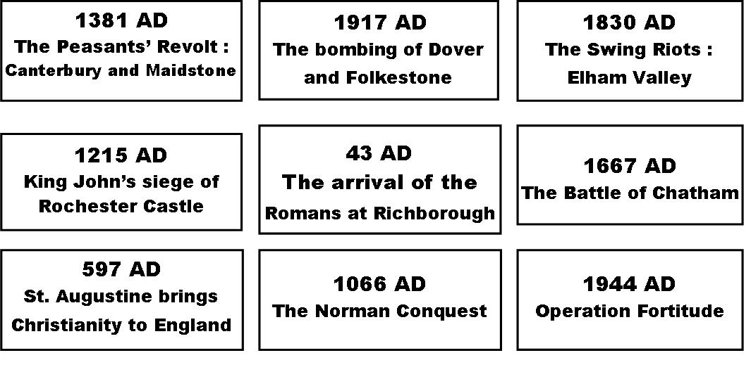
Timeline Activity
1. Sort the events below into chronological order.
2. Add them to the left hand side of your timeline.
3. Which event do you think was most important?
4. How can you measure the importance of events in history?

Slide 5
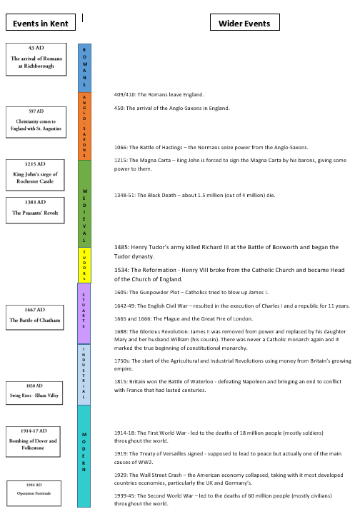
Activity
Look at your timeline again.
What connections are there between events in Kent and wider British events?
Draw lines to connect any linked events.

Slide 6
Factors and Effects
FACTOR: what caused change?
EFFECT: what changes did this event bring about?
Religion: new religious beliefs changed the way that people lived their lives.
War/Invasion: a war with another country or invasion by a foreign country changed the way that people lived their lives.
Science and technology: new inventions changed the way people lived their lives.
Government/control: the way of running the country changed the way that people lived their lives.
Physical : it changed the appearance of Kent (new buildings and other infrastructure or destruction of what was there previously).
Social: it changed the way that people lived (language, food, social structure).
Economic: it changed the way that people made their living/money or changed the type of jobs available.
Political: it changed the way that Kent/England was run.
Religious: it changed peoples’ beliefs.

Slide 7
Plenary
Write down three
questions that you
want answered about
the Kentish events:
1.
2.
3.

Slide 8
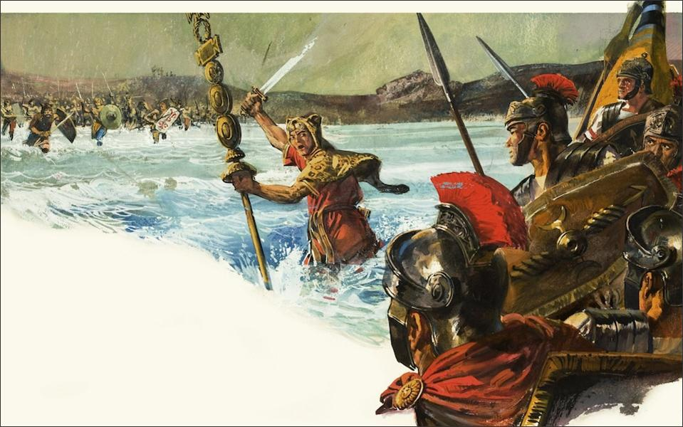
Credit: www.bridgemanimages.com

Slide 9
Lesson 2: What did the Romans do for Kent?
Learning Objectives:
Grade 3+: to explain at least two ways in which the Romans changed Kent
Grade 5+: to demonstrate how life for people in Kent changed under Roman occupation
Grade 7+: to evaluate the effects that the Romans still have on Kent today

Slide 10
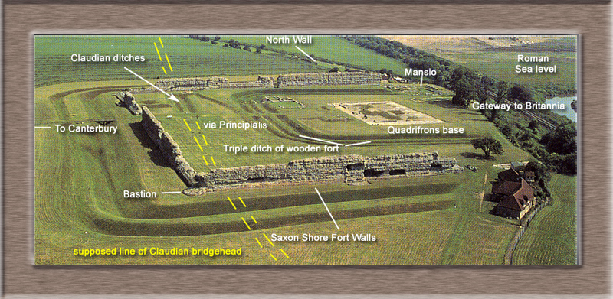
The Romans in Kent
Watch the video and write down 5 things the Romans did for Kent
Richborough Fort (near Sandwich)

Slide 11
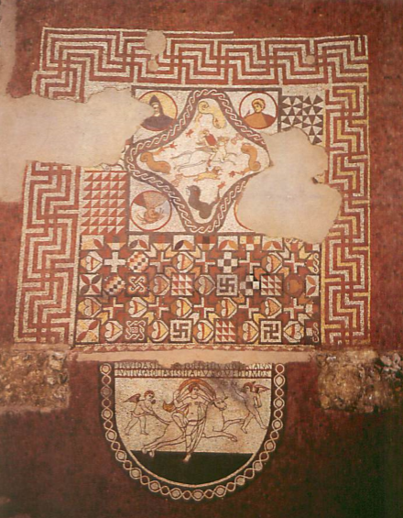
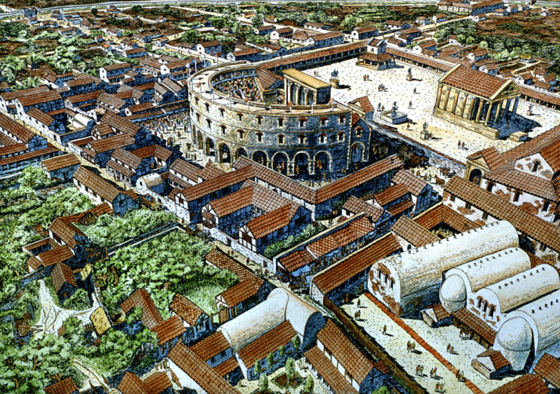
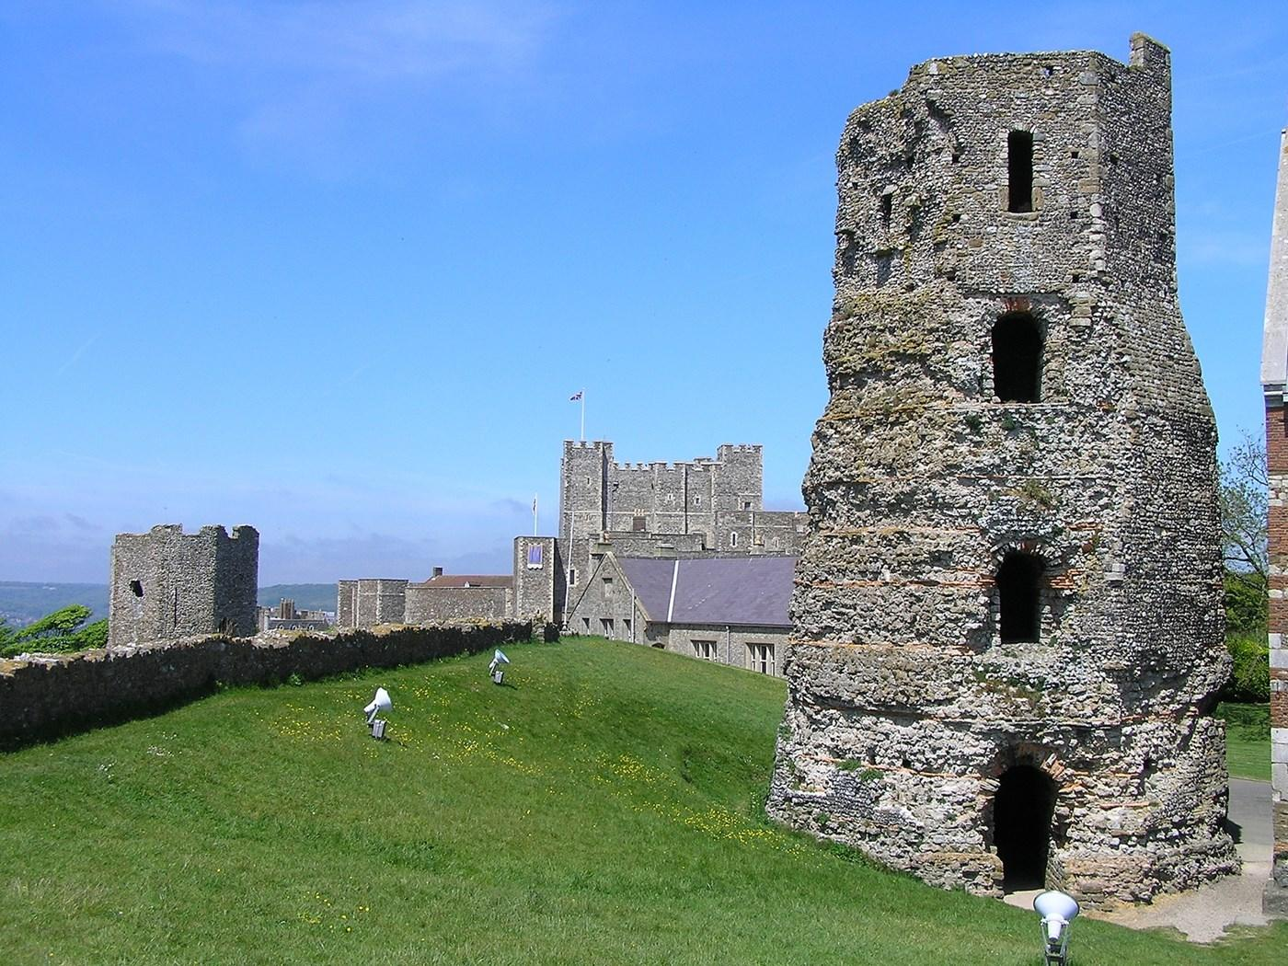
These are all images of things the Romans did in Kent…
Canterbury Archaeological Trust
Wikipedia
...what do they tell you ?
Wikimedia commons
Kerry @ Flickr.com

Slide 12
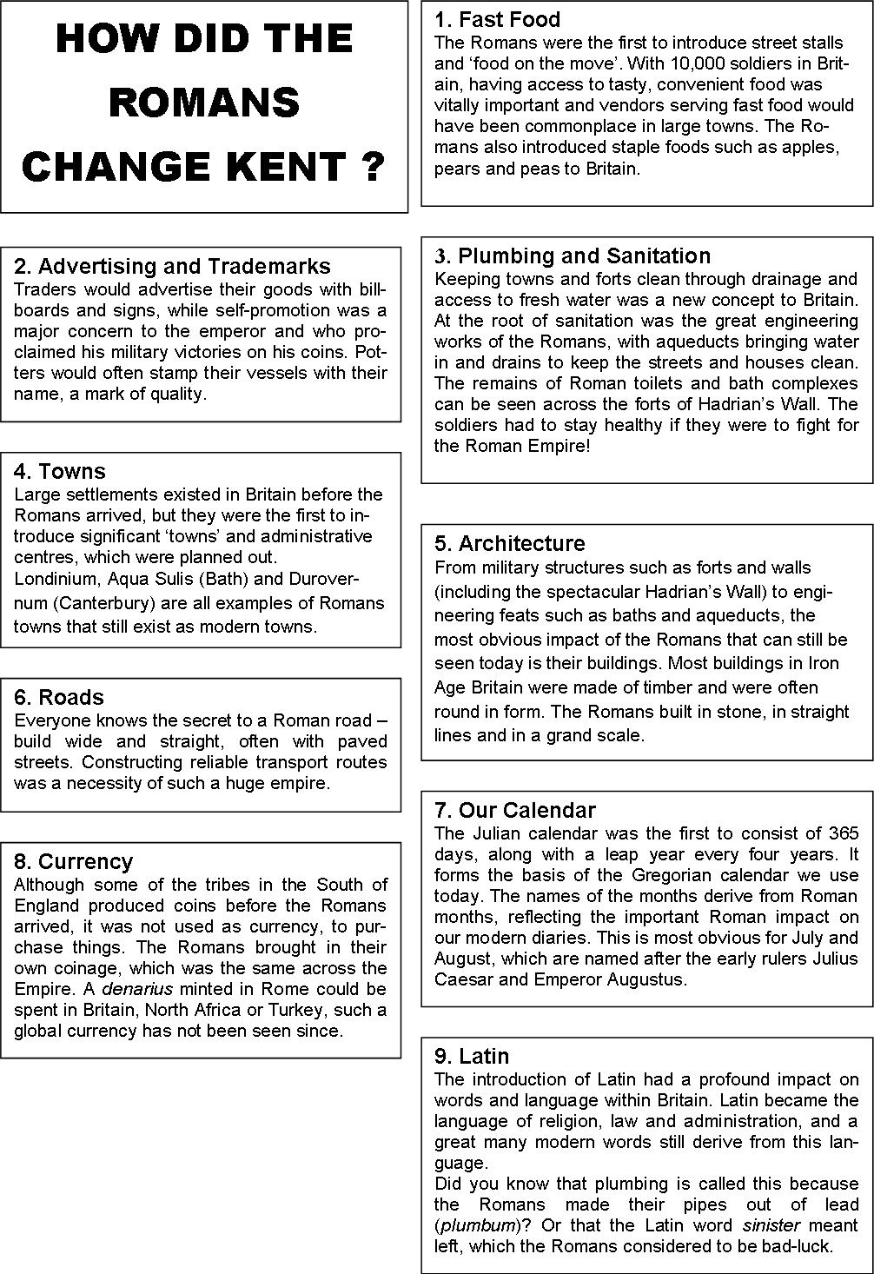
Write a letter home to Rome!
You are a soldier posted in Roman Durovernum in the 4th century AD.
Write home to your family telling them about how the Romans have changed Cantium (Kent).
Use the information sheet to help you. Make sure that you include what you think are the three most important changes.

Slide 13
Plenary
Fill in your importance card for this event
EXTENSION ACTIVITY:
Read the article about the murdered girl. What do you think led to her death?

Slide 14
Lesson 3: How did Augustine and 40 monks change Kent?
Learning Objectives:
Grade 3+: to explain how Christianity came to Britain
Grade 5+: to demonstrate an understanding of how the arrival Christianity created Britain today
Grade 7+: to evaluate how much St. Augustine’s visit changed Britain
Key individuals:
King Ethelbert – King of Kent (a pagan – a non-Christian)
Saint Augustine – a monk sent from Rome by the Pope to convert the English to Christianity
Queen Bertha – King Ethelbert’s wife (she was a Christian)

Slide 15
Starter: What does this picture tell you about the meeting between St. Augustine and King Ethelbert?
From Illustrated Notes on English Church History by the Rev’d C. Arthur Lane, 1884

Slide 16
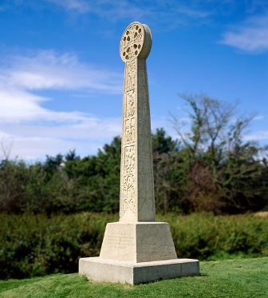
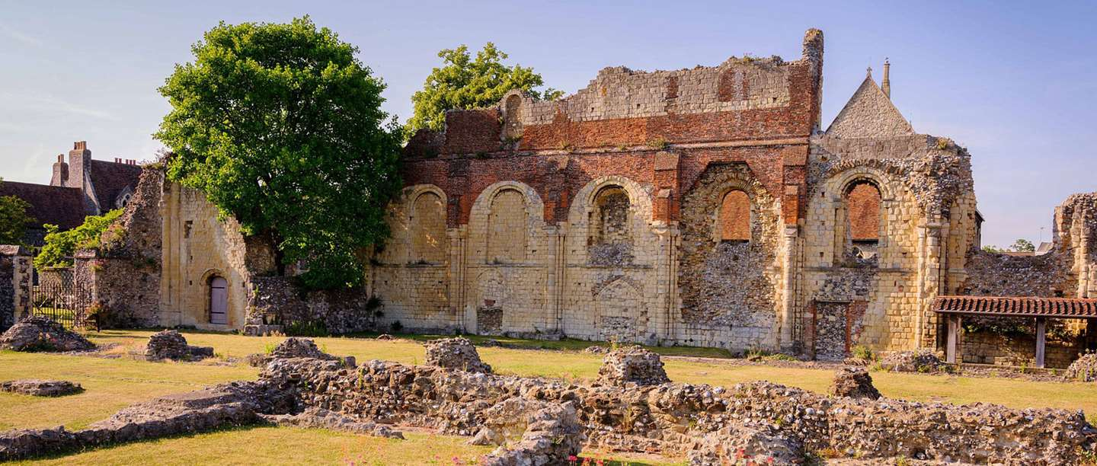
QUIZ TIME!
In pairs, try to answer as many of the questions as possible.
English Heritage
Wikimedia commons

Slide 17
Answers
1.The Anglo-Saxons.
2. Pope Gregory the Great.
3. Someone who believes in a non-Christian religion
4. Bede, the monk and historian.
5. He was worried that St. Augustine might use sorcery (magic) on him!
6. Ramsgate
7. Germany
8. Canterbury – St. Augustine’s Abbey.
9. 89 years.
10. The Dissolution of the Monasteries after Henry VIII broke with Rome.

Slide 19
Plenary
Fill in your importance card for this event

Slide 20
Lesson 4: How much did the Normans change Kent?
Learning Objectives:
Grade 3+: to explain at least two ways in which the Normans changed Kent
Grade 5+: to explain how life for people in Kent changed after the Norman Conquest
Grade 7+: to evaluate the effects of the Norman Conquest

Slide 21
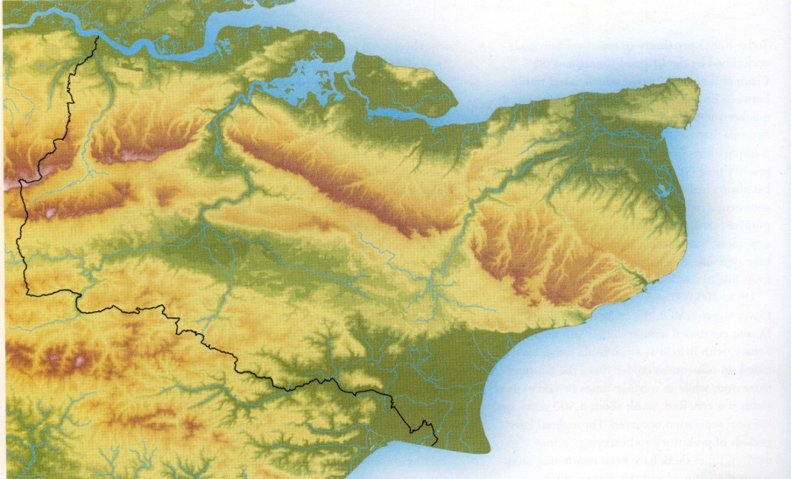
1066: THE NORMANS INVADE KENT!
To London
Soon after winning the Battle of Hastings on 14 October 1066, Duke William and about 5,000 Norman soldiers marched into Kent. He wanted to capture London but needed to take control of Kent first.
Rochester
Canterbury
Maidstone
Ashford
Tonbridge
Dover
They attacked Romney burning the town and killing many of the townspeople. According to William of Poitiers, the Duke’s priest, there was ‘heavy loss on both sides’
When they reached Dover the townsfolk surrendered but the town’s defences were burnt down. The Normans built new defences and left soldiers in charge of the town.
Then the Normans marched to Canterbury. The citizens surrendered and the Normans built a castle there before marching on towards London.
By the end of 1066, when William was crowned King in Westminster Abbey, Kent was firmly under Norman control although it took them another 5 years to conquer the whole country.
New Romney
“Then he marched to Dover, which had been reported impregnable and held by a large force. The English, stricken with fear at his approach had confidence neither in their ramparts nor in the numbers of their troops ... While the inhabitants were preparing to surrender unconditionally, our men, greedy for booty, set fire to the castle and the great part of it was soon enveloped in flames”.
William of Poitiers ‘The Deeds of William, Duke of Normandy and King of England’ written in the 1070s
The Ian Coulson Bursary for Local History/Archaeology in Kent Schools 2019

Slide 22
HOW MUCH DID THE NORMANS CHANGE KENT ?
Study the 11 cards and sort them into 5 groups, according to how much they changed the lives of people in Kent:
little or no change
small changes
quite big changes
big changes
enormous changes
Look back over your choices and decide on an overall answer to the question : how much did the Normans change Kent?
The Ian Coulson Bursary for Local History/Archaeology in Kent Schools 2019

Slide 23
Plenary:
Fill in your importance card for this event
The Ian Coulson Bursary for Local History/Archaeology in Kent Schools 2019

Slide 24
Lesson 5: Why did King John attack Rochester?
Learning Objectives:
Grade 3+: to explain why the Barons were angry with King John
Grade 5+: to discuss how the Barons at Rochester Castle were defeated
Grade 7+: to evaluate how much the Magna Carta and the war between the Barons and King John changed England

Slide 25
STARTER:
Which King introduced the Feudal System to England?
What problems might there have been with it?

Slide 26
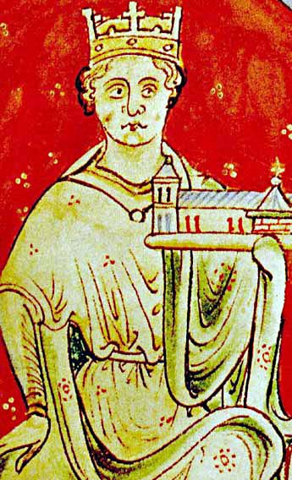
Watch the video
List as many reasons as you can why the barons were unhappy with King John.
KING JOHN (1199-1216) FROM A MEDIEVAL CHRONICLE Wikipedia

Slide 27
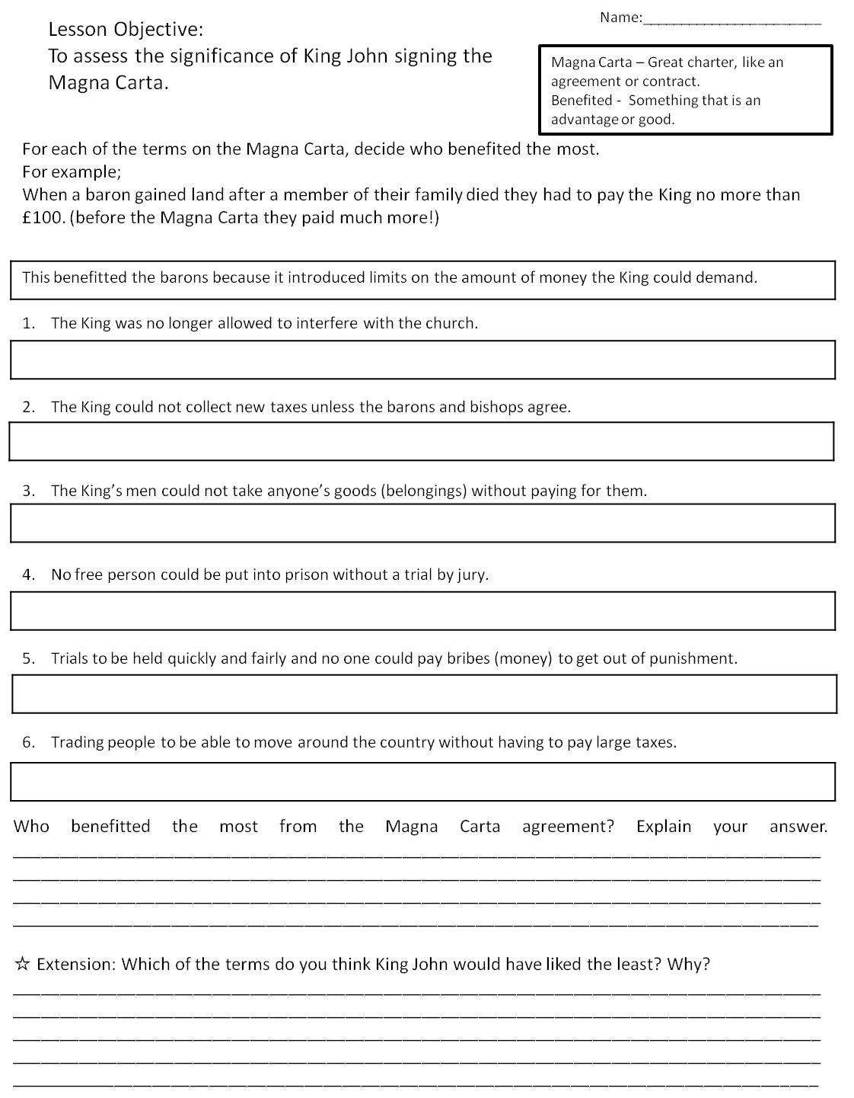
5 Minute Activity
In pairs, look at the sheet on the Magna Carta. Quickly fill in who would have benefitted from each agreement.
Extension:
Why might the Magna Carta have led to more trouble between the King and Barons?

Slide 28
The signing of the Magna Carta was not the end of the story. King John tried to take back what he had signed up to and the barons declared war against him.
Rochester, a royal castle, was under the control of the Archbishop of Canterbury, Stephen Langton. Langton was no friend of the king and he seems to have let the castle pass into the hands of rebels. In September 1215 it was occupied by William de Albini and a small company of knights.
A furious King John commanded the siege of the castle himself. His attacking army broke through the bailey wall and set up stone-throwing machines to destroy or damage the keep. At the same time, a mine was dug under one of the corner towers....

Slide 29
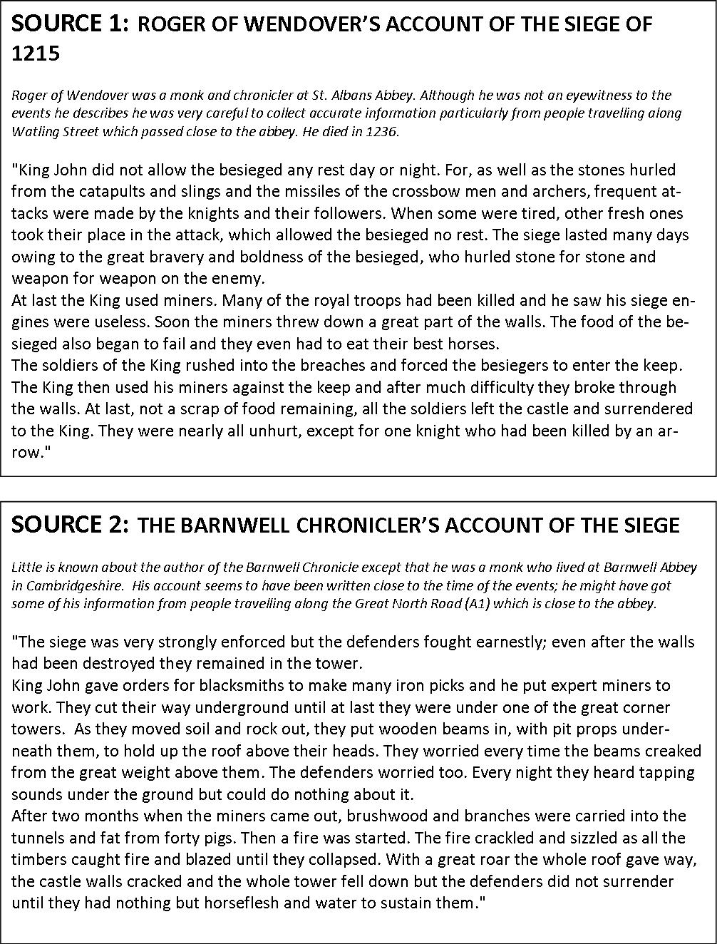
To find out what happened next you need to study some sources from the time:
On what points do the sources agree?
On what points do they disagree?
Which source do you think is the most reliable?
Now watch this clip from the 2011 film ‘Ironclad’ which is based on these events.
Use what you have found out so far to write a short account or make a detailed sketch about what happened at Rochester Castle in 1215.

Slide 30
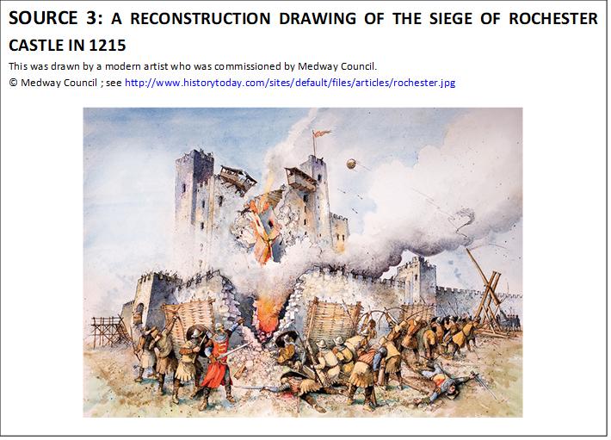
How similar was your drawing or account of what happened? Extension: How useful is this picture to a historian about the Siege of Rochester?
Here is a reconstruction drawing of what happened by a modern artist:

Slide 31
Plenary
Fill in your importance card for this event

Slide 32
Lesson 6: Why were Kentish peasants revolting?
Learning Objectives:
Grade 3+: to explain one reason why the peasants were unhappy
Grade 5+: to demonstrate how different places in Kent were affected
Grade 7+: to evaluate how useful the sources about the Peasants’ Revolt are

Slide 33
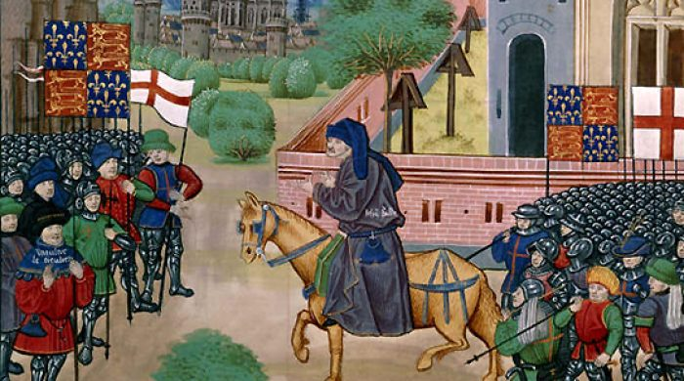
STARTER: What happened in 1381?
Watch the video and make a note of five key facts (people, places, events).
1.
2.
3.
4.
5.
Notes:
https://www.youtube.com/watch?v=WsML7hiTnsY

Slide 34
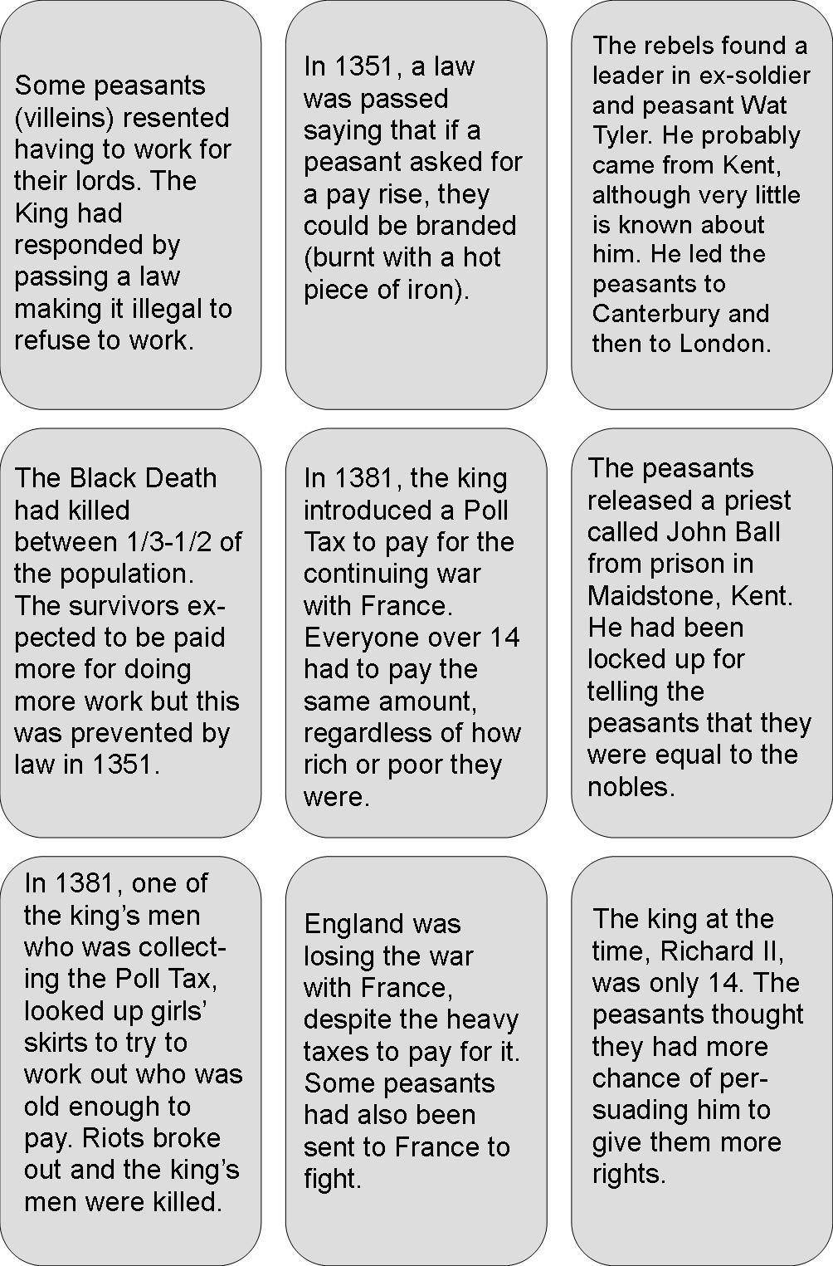
Causes of the Peasants’ Revolt
ACTIVITY: Look at the causes of the Peasants’ Revolt, 1381.
Which do you think was most important?
EXTENSION: Colour code the causes into economic/ political/military/ social reasons.

Slide 35
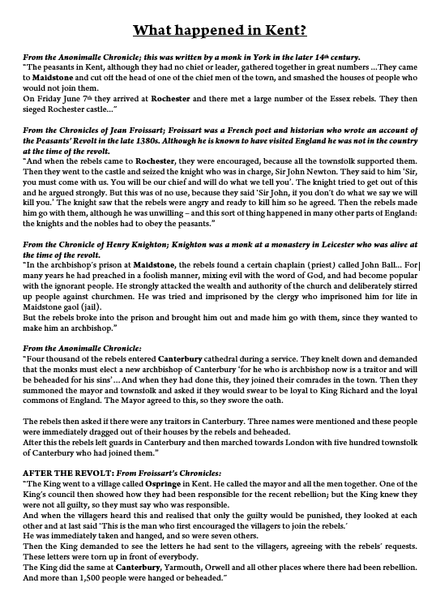
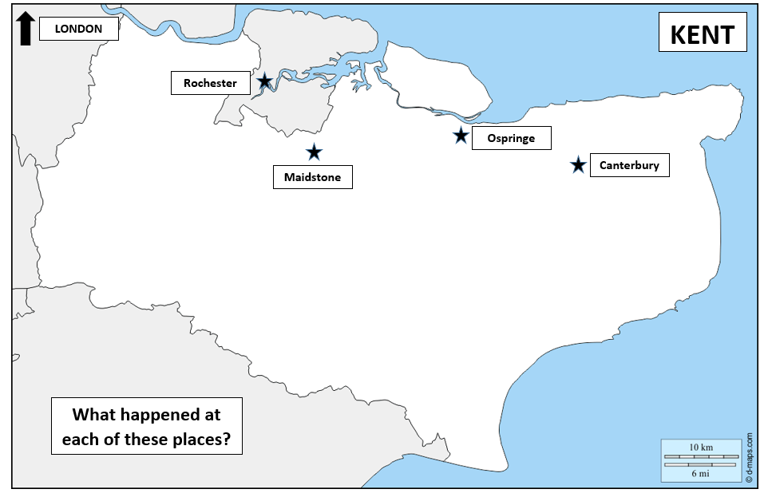
Activity: How did it affect Kent?
Extension:
How useful are these sources to you as a historian?
Think about who wrote them and whether they show any obvious signs of bias.
Read the source sheet.
Use the information to annotate your maps with
details about what happened at each location.

Slide 36
Plenary
Fill in your importance card for this event

